Slide 1
Administrative points
If you have not done so yet, send me your topic interests
Missing names
Student presentations starting on Tuesday
Never too early to start thinking about your projects
I will schedule office hours for project questions as we get closer to the project proposal (starting week of Sept. 15)

Slide 2
CS 395T: LLM Crash Course
August 28^{th,} 2025

Slide 3
Today: LLM Crash course
What’s a language model?
Transformers and self-attention
Bit of pre-training history (BERT)
GPT3, in-context learning
CoT
ReACT

Slide 4
Resources
If you’re hungry for more, check out:
Greg Durrett’s CS388 slides (some of which I stole)
Daniel Khashabi’s CS 601.471/671 NLP: Self-supervised Models slides

Slide 5
Assumed background
Probability
Multi-layer perceptron
NN basics (softmax, classification)
Word embeddings and distributional semantics
Notes:
Before we start, I want to clarify the background that I am assuming the class has
Which is an understanding of probability, especially conditional probabilities,
And some neural network basics, including multi-layer perceptrons, softmax and classification tasks, a basic understanding of gradient descent and supervised learning
I’m also assuming on the NLP side that you have covered word embeddings

Slide 6
What is language modeling?
Predicting the next word
The students sat at ______
desks
tables …
Modeling a probability distribution
Where is a word in a fixed vocabulary.
Notes:
I want to start by defining language modeling as a task,
Which refers to something pretty specific in NLP
Namely the task of predicting the next word in a sequence
So given the prefix The students sat at blank
The task is to predict what the next word should be here
More specifically, we are generally going to treat this as a task requiring us to model a probability distribution,
The probability of the word at position i, given the words that preceded it
Where the support of this distribution is a fixed vocabulary, so we are modeling a distribution over words

Slide 7
What is language modeling?
Assigning probabilities to sequences
This can tell you useful information:
What’s the probability of “The students sat at desks” vs. “The students ate at desks” vs. “The students sat at bananas”?
Notes:
Because we are treating this as a conditional probability distribution, it should also become clear here that language modeling will not only let you assign probabilities to individual words, but to whole sequences
Since we can use the chain rule to decompose this joint probability distribution here into a product of conditional probabilities
Which we can express more compactly like this, where the notation “less than I” indicates all indices less than I
Modeling this kind of probability distribution over sequences turns out to be an incredibly powerful tool, and can tell us useful information
For example we can score different sentences and this can tell us that the probability of a sentence like “the students sat at bananas” is extremely unlikely, while “the students sat at desks” is much more likely

Slide 8
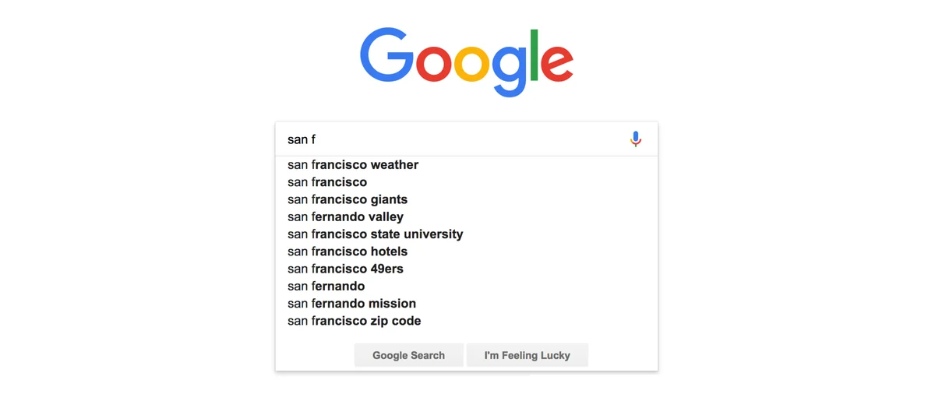
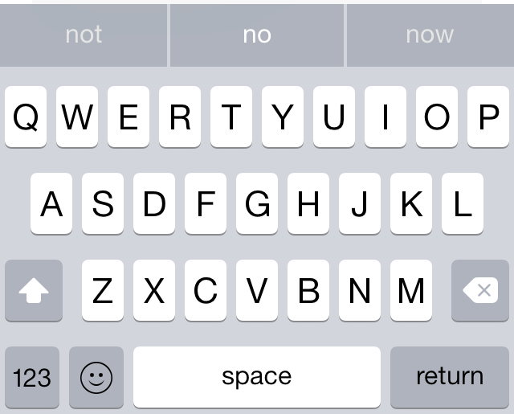




Why do language modeling?
Practical applications
Large language models
Notes:
In fact you probably interact with language models on a daily basis
Some common applications are things like autocomplete or assistive typing, where suggestions are made to you based on how likely they are under some language model
But of course you’ve also by now probably interacted with and used large language models
Which at their core rely on many of the same concepts that we will cover today, albeit with more complex models that we don’t have time to get into

Slide 9
How to learn a language model?
Q: How do you learn a language model from data?
One approach: n-gram language model
N-gram = n consecutive tokens
The students sat at desks
Unigram: The, students, sat, at, desks
Bigram: The students, students sat, sat at, at desks
Trigram: The students sat, students sat at, sat at desks
Four-gram…
General idea: estimate probability via count
Notes:
What I want to do today is briefly introduce how we can learn a language model from data
Language is incredibly complex and so in this case, we can’t specify this probability distribution over language ourselves, we want to instead estimate it from a sample of language observations
We’re going to start with a simpler model here and then move on to trying to understand more complicated models
Specifically we’ll start with an N-gram language model
An n-gram is a name for a sequence of n consecutive tokens
So for example given this sentence The students sat at desks
You can have different n-grams, with unigrams being sequences of length one, so the, students, etc.
Bigrams being pairs of words, like the students, students sat
Trigrams being groups of three, etc.
Weirdly, once we go past three, we start saying four-gram, five-gram, etc.
The general idea with n-gram models is that we are going to estimate the probability of words based on their count, how often they appear with other words in a given set of data

Slide 10
Estimating probabilities
Estimate the probability of a word by looking at the count
Markov assumption: depends only on the preceding words
Conditional probability
words
gram
gram
Notes:
And we’re going to make a Markov assumption here
That means we are going to enforce a kind of horizon, where we say that each word is only going to depend on a fixed window of preceding words
This is of course a simplifying assumption, of course you can find cases where that’s not true, but it will allow us to model this distribution more easily
Now instead of having to model the probability of a word given ALL the previous words, we are only considering the previous n-1 words
Now you should start to see the connection to n-grams already
This will become clearer if I rewrite the conditional probability here in terms of joint probabilities, like this
Which is just the probability of an n-gram, divided by the probability of the same n-gram with the last word removed, so the n-1 gram

Slide 11
Estimating probabilities
Estimating via counts
The students sat at desks
The students sat at tables
The parents sat at tables
The students ate at desks
Notes:
In n-gram models we are going to estimate these probabilities by their counts
So given some text we are going to count up how often these different sequences appear
To give you an example, let’s say we start with these sentences here and we’re estimating a trigram model, so n=3
If we want to know the probability of tables given “sat at”
We would count the number of times the trigram “sat at tables” appears and divide by the number of times “sat at” appears
So we see two times that “sat at” lead to “tables”
And one time it didn’t
So we would estimate the probability as 2/3

Slide 12
What’s wrong with n-grams?
Markov assumption discards useful information
Sparsity
Longer n-grams = better model (higher-order Markov assumption)
Longer n-grams = more sparsity, zero probability
Smoothing: add a small value
to all words in vocab so we don’t get zeros
The students sat at desks
The students sat at tables
The parents sat at tables
The students ate at desks
But we know
Why is having zero probability especially bad?
What about ?
Backoff: If the full conditioner does not occur, use a smaller n-gram (at)
Notes:
I mentioned at the start that we would start covering some other models today, so I want to motivate that by discussing briefly what’s wrong with n-gram models
The first limitation here is that the markov assumption discards useful information
We’re ignoring the fact that if you say the word student in this example, it tells us something meaningful about the sentence, probably that they sat at desks, which is where you often find students
I want to get some suggestions now on how you could get around this Markov assumption limitation (wait for responses)
Exactly, so you could extend the n-grams to get around this limitation a bit
This raises another key issue, which is sparsity
The longer your n-grams are, the better your model should be, since you’re now looking at a longer context, what we would call a higher-order markvo assumption
But as you get longer sequences, you are more likely to get things that never occurred, meaning they will have an estimated probability of 0 according to a corpus
Let’s go through an example of this, because it’s an important property
Let’s say we have our same examples from before
And we want to know what the probability of counters is given “sat at”
Now we would estimate this by looking at the count of the trigram “sat at counters”, which doesn’t occur at all.
So our probability estimate here would be zero
But of course we know as speakers of English that this phrase does not have zero probability! It’s completely possible, so this is an issue
I also want you to now think for a minute about why having zero probability is particularly bad in this setting, any thoughts?
Exactly, because we are multiplying probabilities together to get sequence probabilities, having a zero anywhere means the whole sequence has zero probability
In practice, we can solve this by doing something called smoothing, where we add some small default value to all possible n-grams. This lets us at least avoid having zeros that flip all our sequences to zero
Another issue that comes up with sparsity is what if we are missing the conditioner
For example, what if we want to know the probability of “tables” given “rested at”,
Well here, “rested at” never occurs in our corpus, so this would actually give us a zero-division error
The way we can handle this in practice is called backoff, where if the full conditioner doesn’t occur, we will back off to a smaller n-gram, so we would look at the probability of “tables” given just “at”, which does occur.
Ultimately these sparsity issues end up being a big problem for n-gram models, and were part of the reason the field since moved on to other models.

Slide 13
Neural LM
Word embeddings: continuous vector representations of words
Fewer sparsity issues in continuous space!
Multi-layer perceptron
{desks: 0.53
tables: 0.38
chairs: 0.21
…
bananas: 0.00001}
Bengio et al. (2000)
…
What is one key problem with this approach?
The
students
sat
at
Notes:
Specifically what I want to cover today is laying some of the groundwork for neural language models, which are in fact the kinds of models you would interact with in most applications, and are what powers large language models.
We will start with a neural version of an N-gram model
A key issue with modeling things neurally is how we are going to represent the inputs
Remember that Neural networks generally deal with vector inputs, so there’s a question of how we are going to represent the words in terms of vectors
Luckily we have a tool in our toolkit already for this, which is a word embedding
which is a continuous dense vector representation of a word, usually representing its distributional qualities
The great thing about these is that there are fewer sparsity issues in continuous space
Even if we have never seen a word before, we can place it in our vector space and generalize from having seen similar words
So if we have seen the word student, maybe we can still handle the word pupil
The model itself will be pretty straightforward
We are going to take our vectors for each word, in this case The students sat at, with some embedding dimensionality
And we will again define some fixed window
And concatenate these vectors together, passing them to a multi-layer perceptron, which we have already seen
Remember that this is just a fully-connected neural network with some hidden dimension, which keeps transforming these vectors in the middle into new spaces with nonlinearities in between
and then at the end we will have a classification layer that projects that hidden representation out to the output space, which in this case is the vocabulary
So we have a weight that goes from the hidden dimension to the output dimension and gives some unnormalized score to each element
And then we have softmax layer that gives us a distribution over words in our vocabulary
So we would get some probability for desks, tables, chairs, but also all the other words in our vocabulary
Now this might seem like an excessively simple language model
But it was one of the first neural language models to be trained, proposed by bengio et al in 2000, which is a name you might recognize
Here I again want to ask all of you: what is one of the key limitations of this approach? I’ll give you a hint that current language models do not look like this, can you think of why

Slide 14
Basic neural LM still has a fixed window!
We need to define a dimensionality for the input weight matrix
If we want more context → bigger weight matrix, more expensive computation
Language involves dealing with variable-length inputs!
The
students
sat
at
Notes:
We still can’t get around the fact that dealing with language means dealing with variable-length inputs
Here, we need to define the dimensionality for this input weight matrix, in this case we looked at three-grams so it was in R 3e times d
The more context we want, the bigger of a matrix we’ll need, and the more costly the computation will become,
So if we want to look at 4 grams we would need a bigger matrix, in R 4e times d
And fundamentally language involves variable-length inputs, which is part of what makes it such an interesting and general problem!

Slide 15
Recurrent neural LM
Apply same weights repeatedly
Weight to map inputs to hidden states
Weight to bring forward hidden state
{desks: 0.53
tables: 0.38
chairs: 0.21
…
bananas: 0.00001}
Elman, 1990
Bengio et al.,1994
Hochreiter and Schmidhuber, 1997
The
students
sat
at
Notes:
Very briefly, I want to give you the high level intuition for a different kind of model, which is a recurrent Language Model, that we will cover as the next unit
We won’t get into the details here but I want to give a high level idea of how this solves the fixed window size problem, and we’ll then get more into how to train these models and other neural LMs in the next class
The key idea here is that we are going to re-use the same weights for multiple tasks, and we will have state that we carry forward across timesteps.
Rather than treating our input as a whole sequence at once, we are going to process it incrementally
Starting with the first word, the
We’ll have one weight matrix that maps this into a hidden state
And then repeat this process with the next word students
But after the first step, we will have the subsequent hidden state be informed not only by the word students
But also carry through some information from the previous timestep
Now I’m also not showing the internals here, where there are of course nonlinearities between these different layers
And we’ll repeat this for the subsequent words
Until we get to the last word in the input sequence
At which point we can throw our classification layer on top of that along with the softmax, just like we had before
And we’ll get our output
This class of approaches is generally called a recurrent neural network, because there is this kind of recurrence from one state to the next
And again here this is not a completely new architecture, we are now about 35 years after this kind of recurrent architecture was first proposed

Slide 16
Detour: Contextualized embeddings
In contrast to something like GLOVE (Pennington et al., 2014) or word2vec (Mikolov et al., 2013)
These embeddings were fixed per word: “apple” means the same thing no matter the context
Context matters
“I ate an apple” is (hopefully) talking about a different apple than “Apple stock rose by 0.5%”
We want our embeddings to be “contextualized”, i.e. different given different contexts
RNNs can actually give us “contextualized” embeddings

Slide 17
Recurrent neural LM
What if we just take the hidden state instead of the embedding?
Now sat depends on “The students” and maybe encodes something different from “The elephants sat”
We can make this bidirectional to get the right context
This was done pre-BERT
ELMO (Peters et al., 2018)
Feb. 2018
BERT (Devlin et al., 2018)
Oct. 2018
We’ll come back to this
{desks: 0.53
tables: 0.38
chairs: 0.21
…
bananas: 0.00001}
The
students
sat
at
Notes:
Very briefly, I want to give you the high level intuition for a different kind of model, which is a recurrent Language Model, that we will cover as the next unit
We won’t get into the details here but I want to give a high level idea of how this solves the fixed window size problem, and we’ll then get more into how to train these models and other neural LMs in the next class
The key idea here is that we are going to re-use the same weights for multiple tasks, and we will have state that we carry forward across timesteps.
Rather than treating our input as a whole sequence at once, we are going to process it incrementally
Starting with the first word, the
We’ll have one weight matrix that maps this into a hidden state
And then repeat this process with the next word students
But after the first step, we will have the subsequent hidden state be informed not only by the word students
But also carry through some information from the previous timestep
Now I’m also not showing the internals here, where there are of course nonlinearities between these different layers
And we’ll repeat this for the subsequent words
Until we get to the last word in the input sequence
At which point we can throw our classification layer on top of that along with the softmax, just like we had before
And we’ll get our output
This class of approaches is generally called a recurrent neural network, because there is this kind of recurrence from one state to the next
And again here this is not a completely new architecture, we are now about 35 years after this kind of recurrent architecture was first proposed

Slide 18
Why not RNNs?
Slow: They do not parallelize and there are O(n) non-parallel operations to encode n items
Sequential dependency/lost context: Even modifications like LSTMs still don’t enable learning over very long sequences. Transformers can scale to thousands of words!
Meaning gets washed out across steps

Slide 19
Attention and Self-Attention
Think of this as a kind of “soft” dictionary lookup table
Keys, Queries, Values
{“apple”: “A reddish fruit…”, …}
“apple”
Key
Value
Query
{
: }

Slide 20
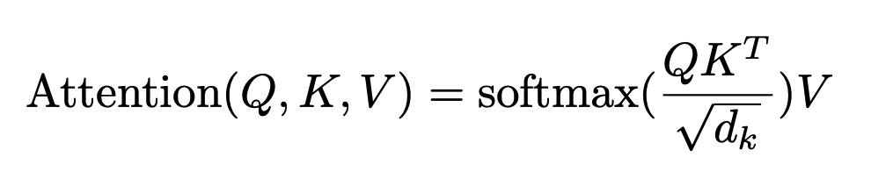
Self-Attention Transformer (Vaswani et al.)
Average values together, weighted by how well they match
E is our word embedding (non-contextual for now)
W’s are weights (projecting embedding to latent space)
Normalization to control scale
This is just one head of attention
Q = EW^{Q}, K = EW^{K}, V = EW^{V}
Get soft match between query and keys

Slide 21
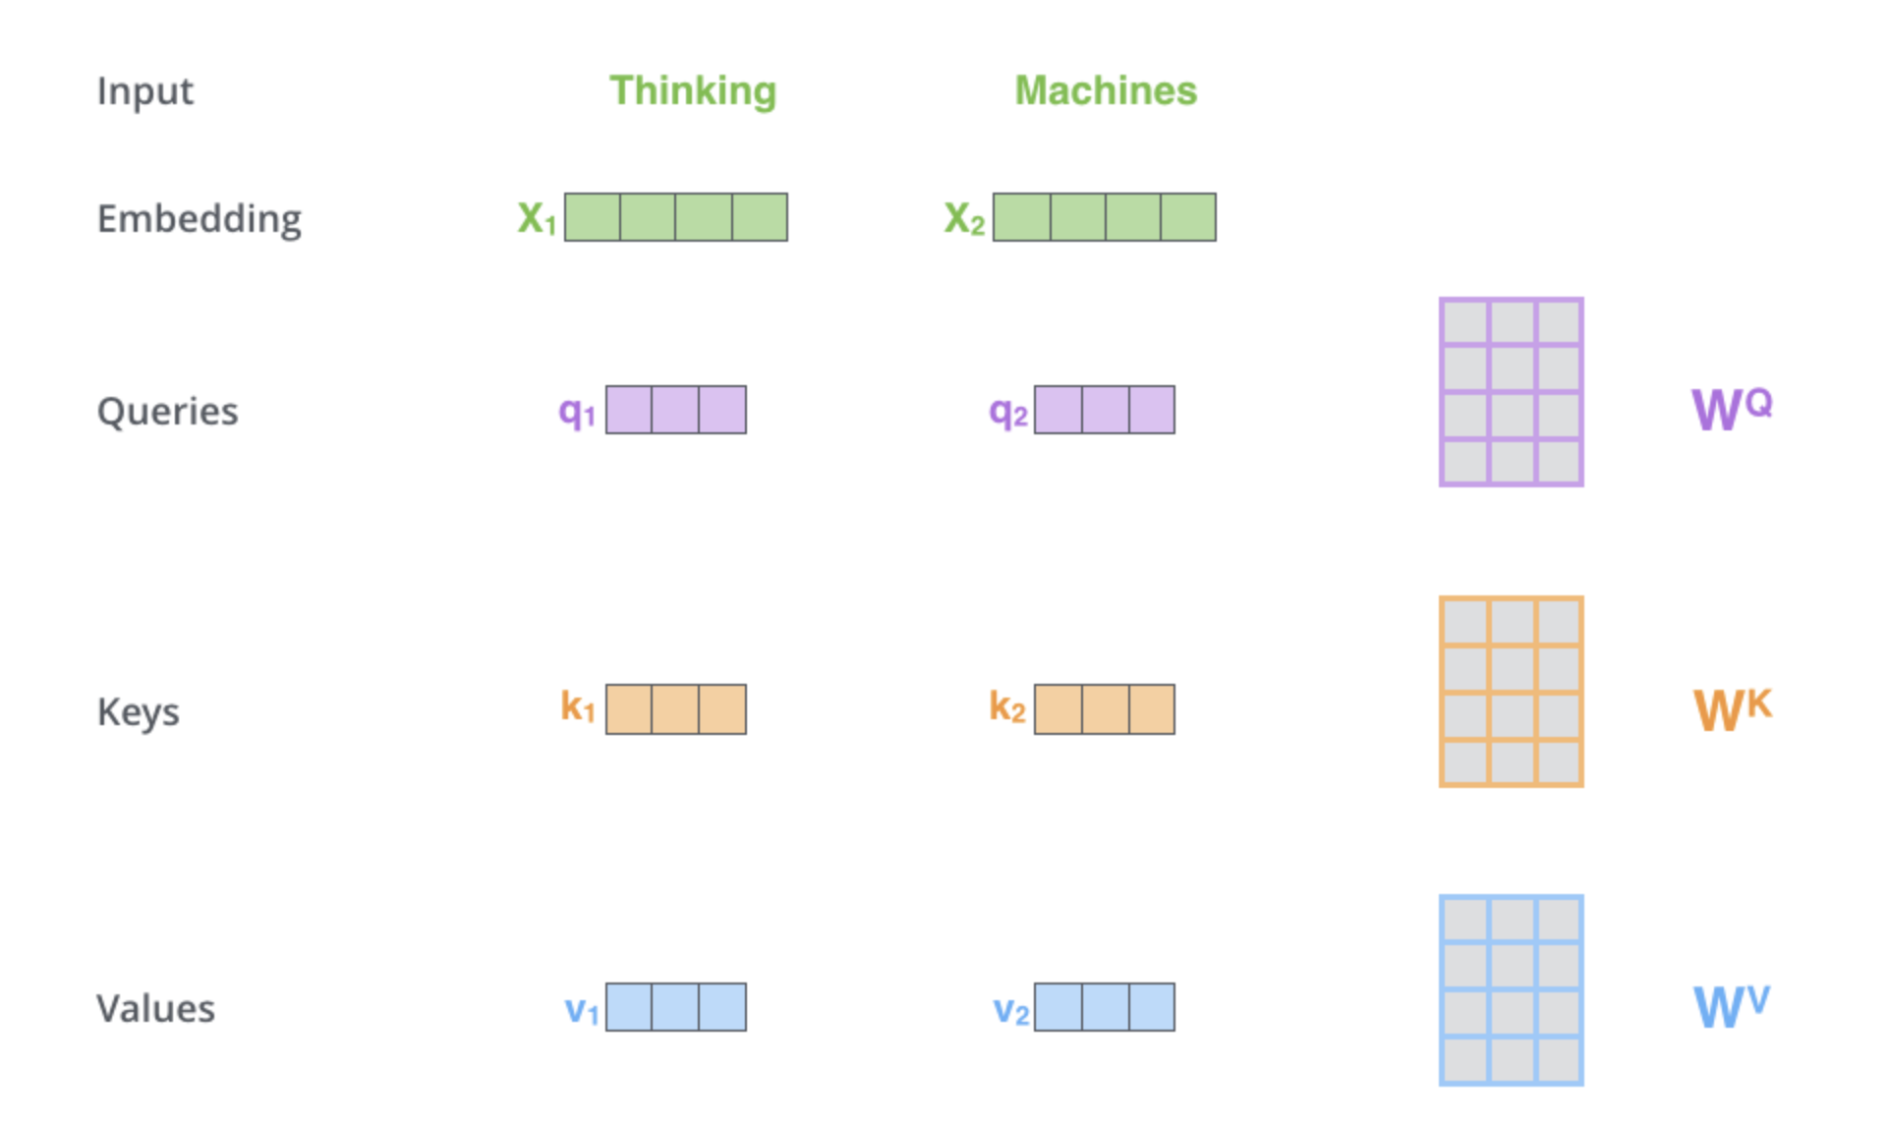
Self-Attention
Alammar, The Illustrated Transformer

Slide 22
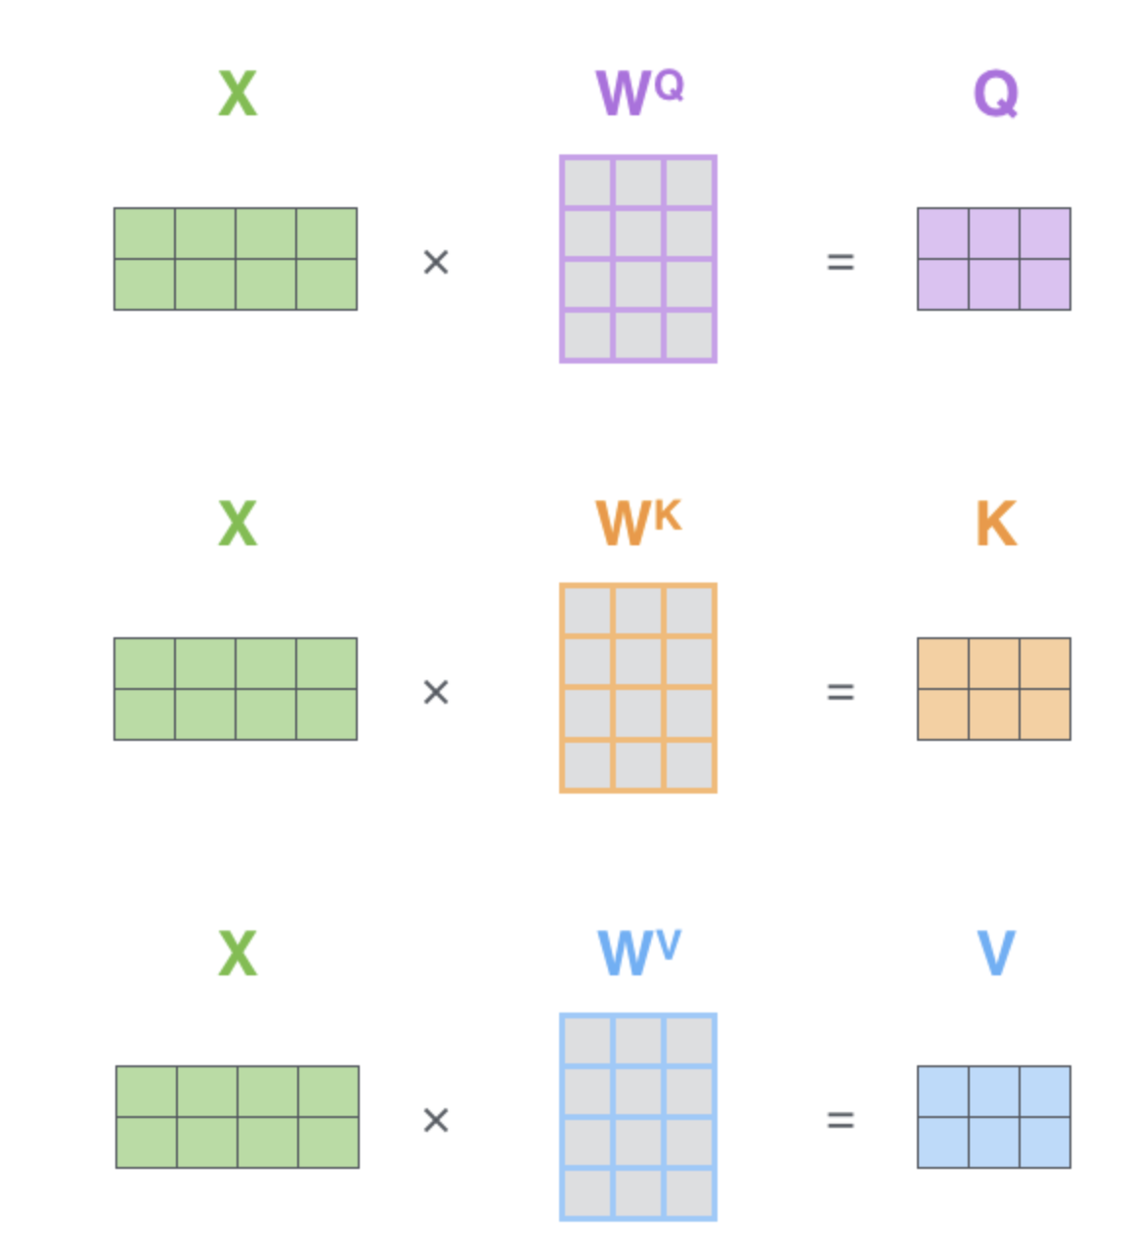
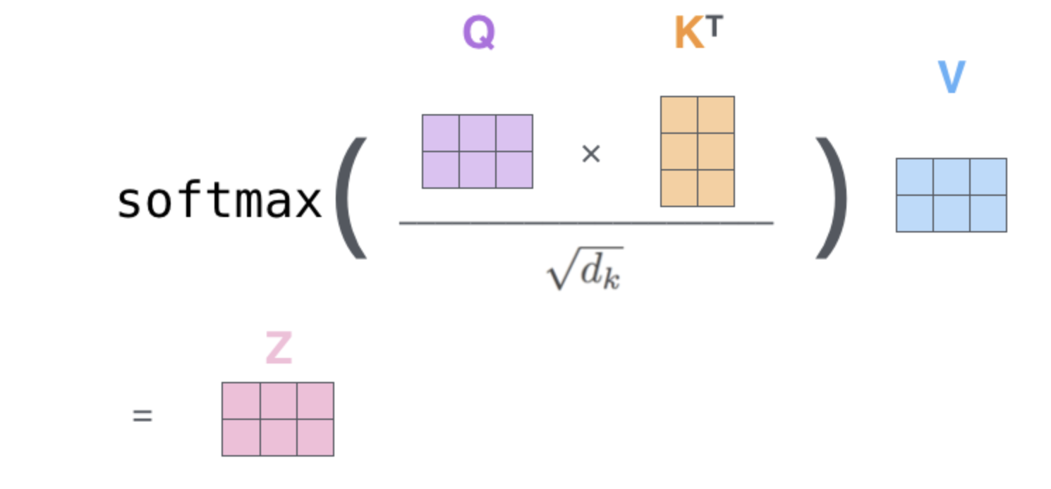
Self-Attention
Alammar, The Illustrated Transformer
sent len x sent len (attn for each word to each other)
sent len x hidden dim
Z is a weighted combination of V rows

Slide 23
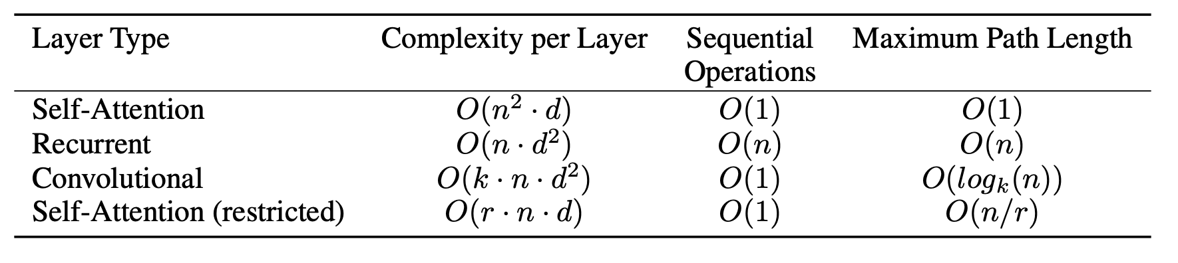
Why is this better?
n = sentence length, d = hidden dim, k = kernel size, r = restricted neighborhood size
Quadratic complexity, but O(1) sequential operations (not linear like in RNNs) and O(1) “path” for words to inform each other
So very parallelizable!

Slide 24
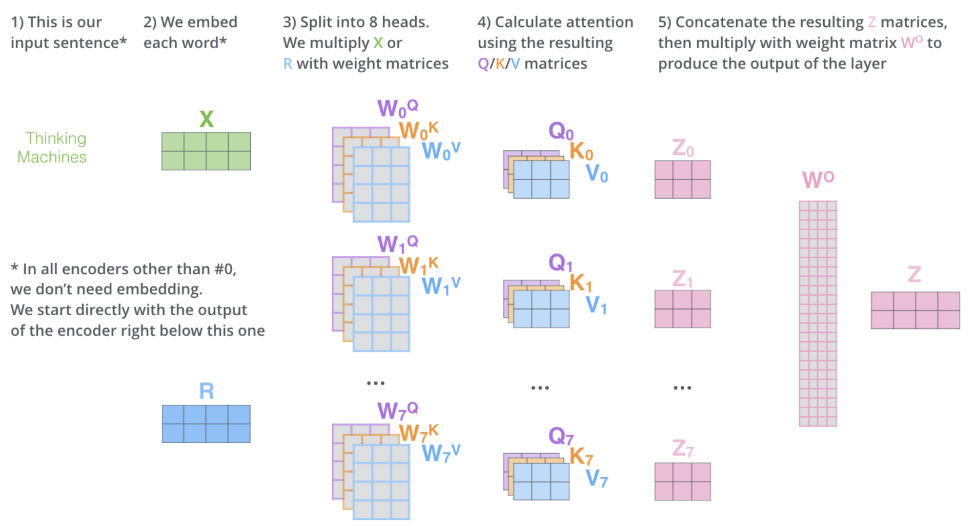
Multi-head Self-Attention
In practice, Transformers have many copies (heads) of self-attention
Also parallelizable

Slide 25
Multi-head Self-attention

Slide 26
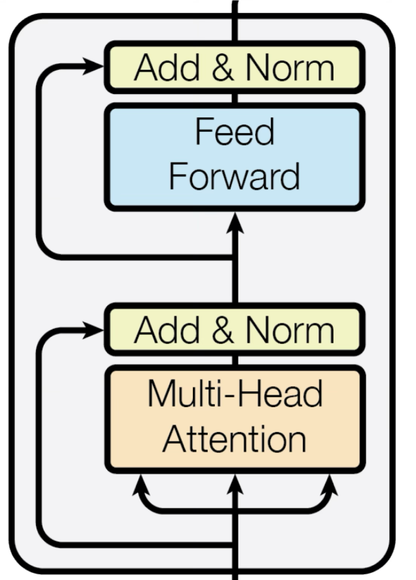
Full Transformer stack
Repeated layers with the same substructure
Multi-head attention
Residual + Layernorm
FFN (most of the parameters)
Residual + Layernorm
Note: there are many variations on this basic theme
Most prominently: Pre-norm

Slide 27
BERT (Devlin et al., 2018)
Pre-trained Transformer model
A bit of historical context
The last big NLP revolution before this was ~2013/2014 with word embeddings
Before that: words = 1-hot vectors
Word embeddings: learned vector representations of word distributions
Brought in a crucial idea: these vectors are something that can be shared across the community
Word2vec and Glove were made publicly available and easy to download and use
BERT follows this paradigm but for a whole model
Instead of just sharing the embeddings, share a model that can embed words on-the-fly

Slide 28
Masked language modeling (MLM)
Normally when we train a language model
Treat it like an N-gram model (P(token | prefix))
BERT introduced a different paradigm, enabled by Transformer’s architecture
This is a sentence we are modeling
This is a _____ we are modeling
Model: P(____ | This is a … we are modeling)
Questions for you:
Why is this something that’s easier to do with a Transformer than an RNN?

Slide 29
Special tokens
BERT also introduced a few “special” tokens
[MASK]: masking tokens (for filling in blanks)
[CLS]: Classification token (pooled representation of the whole sentence/input)
[SEP]: separating sentences/lines/documents

Slide 30
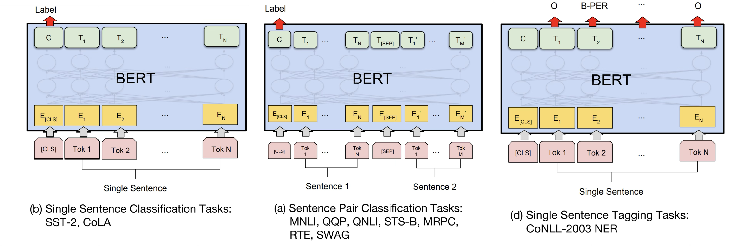
A few things BERT can do:
Classification with [CLS]
Similarity
Token-level tagging

Slide 31
Question: What is missing here?
What can’t BERT do (at least, not easily)?

Slide 32
Results
For the sake of time, we will skip detailed results
TLDR: BERT vastly outperformed most prior solutions across most tasks
To the point where the tasks NLP cared about fundamentally changed
For most applications, BERT + Finetuning became standard approach
In general, LLMs do better across tasks now (and the tasks we care about have changed)
Exception: retrieval (e.g. ModernBERT)
Main innovation/takeaway:
Shift in NLP towards using shared models
Transformers library introduced (which would later become Huggingface)

Slide 33
GPT-3 and Prompting/Few-shot Learning
Between BERT and GPT-3: GPT-2
Big news
Encoder-only vs. Decoder-only
Encoder-only
All the tokens come in at once (like BERT)
Can’t generate
Decoder-only
”Autoregressive”, one token at a time
Generates, but not as good as an embedding
SCALE!
BERT-Large (340M) → GPT2 (774M) → GPT3 (175 B)

Slide 34
Zero-shot Prompting
You have a single datapoint x that you want to predict a label y for
E.g. if you’re doing sentiment analysis
You add a “prompt” which tells the model what you want it to do
For models like GPT3, this needed to be an autoregressive prompt
x = The movie’s acting could’ve been better, but the visuals and directing were top-notch.
Review: The movie’s acting could’ve been better, but the visuals and directing were top-notch.
On a scale from 1 to 5, this review is a

Slide 35
Few-shot prompting
Brown et al. (2020)
Add multiple examples of the task you want to the prompt
Review: The movie was a complete disaster On a scale from 1 to 5, this review is a 1 Review: I loved this movie, it’s my favorite
On a scale from 1 to 5, this review is a 5
Review: The movie was average, I don’t feel strongly about it
On a scale from 1 to 5, this review is a 3
Review: The movie’s acting could’ve been better, but the visuals and directing were top-notch.
On a scale from 1 to 5, this review is a

Slide 36
Few-shot prompting
Powerful way to shape model responses
Teach the task you want the model to do
No training needed!
Not much data needed (5-10 examples are common, instead of 1000s for training)
Open questions
How does ICL work?
Can ICL teach models new information?

Slide 37
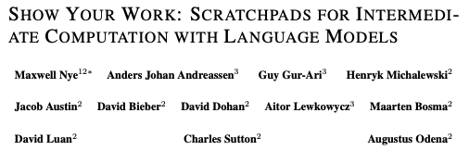
Chain-of-Thought
Wei et al. (2022)
Most well-known paper in line of work now thought of as “reasoning”
Actually comes after “scratchpad” work
Seemingly-simple idea:
Ask model to reason “step-by-step” in the prompt
Nye et al. (2021)
Review: The movie’s acting could’ve been better, but the visuals and directing were top-notch.
Give the score for this review on a scale from 1 to 5. First, let’s reason step-by-step…
It seems like the author wasn’t satisfied with the acting
The author highlights “top-notch” visuals and directing
Based on this, I would give the movie a 4

Slide 38
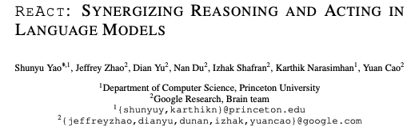
Putting things together

Slide 39
About the paper
ICLR 2023
Coming from a group working generally on agents
Last author was on GPT2 paper
We’ll see other datasets/papers from the same group

Slide 40
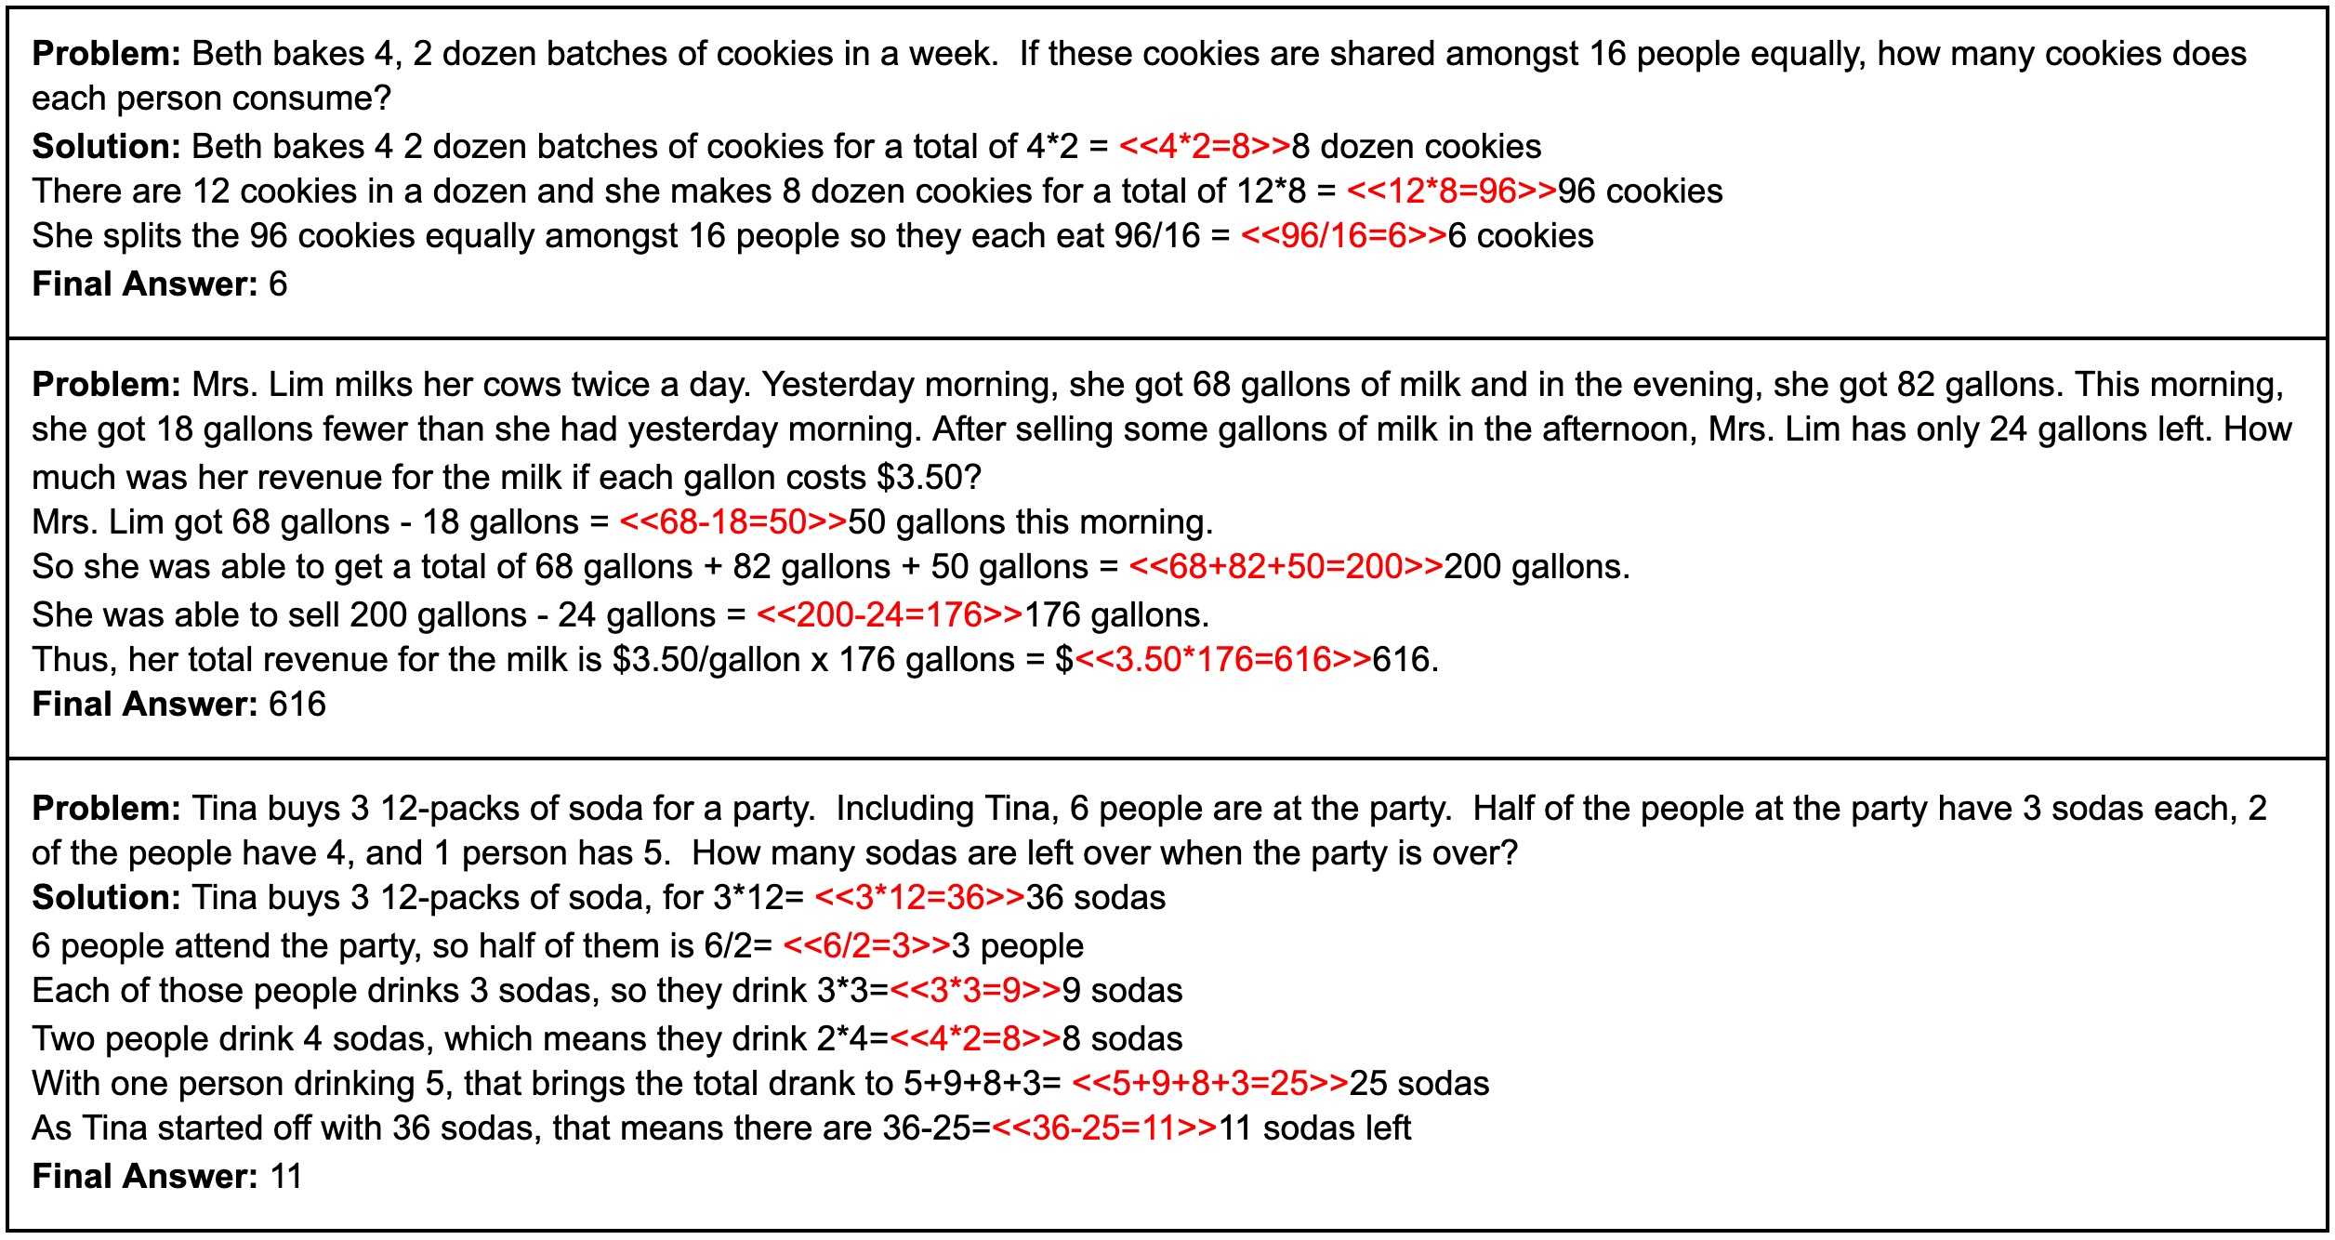
Background
CoT: improves heavily on reasoning
LLMs applied to reasoning tasks like GSM8K (math reasoning)
OpenAI (2021)

Slide 41
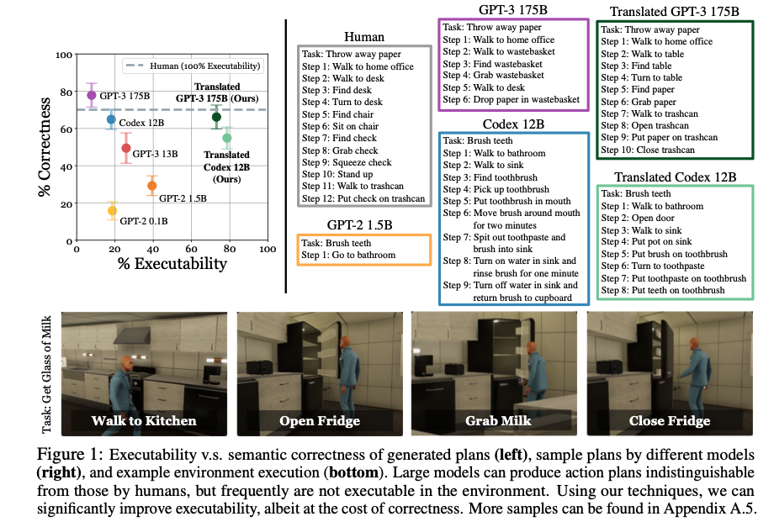
Background
We’ll see later in the course: LLMs applied to action
Huang et al. (2022)

Slide 42
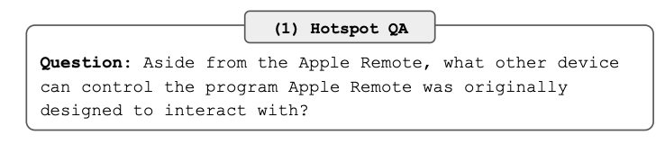
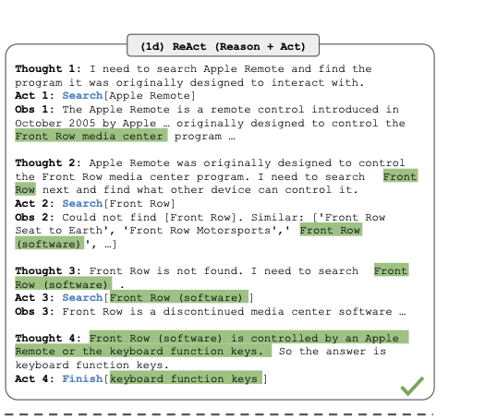
ReACT: Combining these two directions
First reason (produce a CoT), then produce an action
ReACT is effectively a prompt format
Encourages model to produce “thoughts” before acting

Slide 43
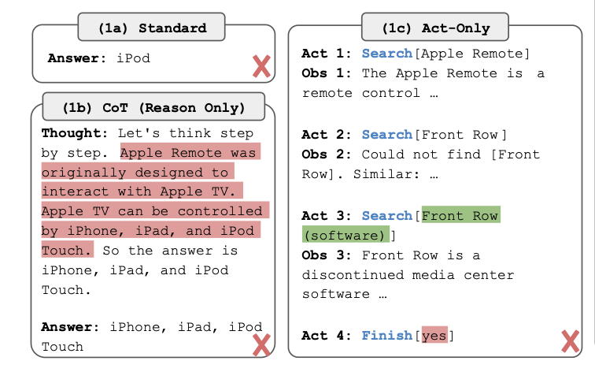
Problem with CoT and action only
CoT only: good reasoning, but actions don’t correspond to anything that the agent can actually do
Act-only: actions are real, but they are not correct

Slide 44
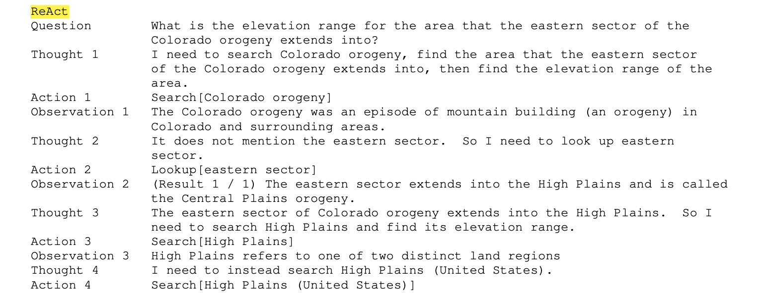
ReACT approach
“augment the agent’s action space to… the space of language”
Sounds complicated
Easier to understand by just looking at the method (in appendix)
ICL example
Human-written thought (2 purposes)
Human-written action
Observation
from env. after
executing action
Notes:
2 purposes:
Give the “thought” format, instruct model on what kinds of thoughts to produce/how to think about the problem

Slide 45
ReACT is using ICL
6 ICL questions
Each has a sequence of <thought, action, observation>
These sequences instruct the model on how to respond to a given question/observation

Slide 46
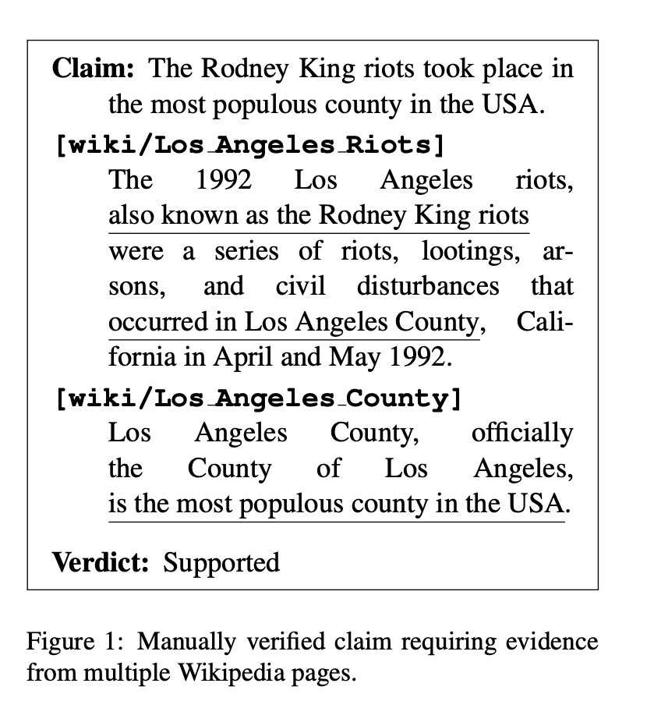
Datasets
QA
HotpotQA: requires multi-step reasoning over multiple Wikipedia passages
FEVER: fact verification with claims that are supported, refuted, or neither (not enough info) based on Wikipedia
Actions: search, command+F, finish
Yang et al. (2018)
Thorne et al. (2018)

Slide 47
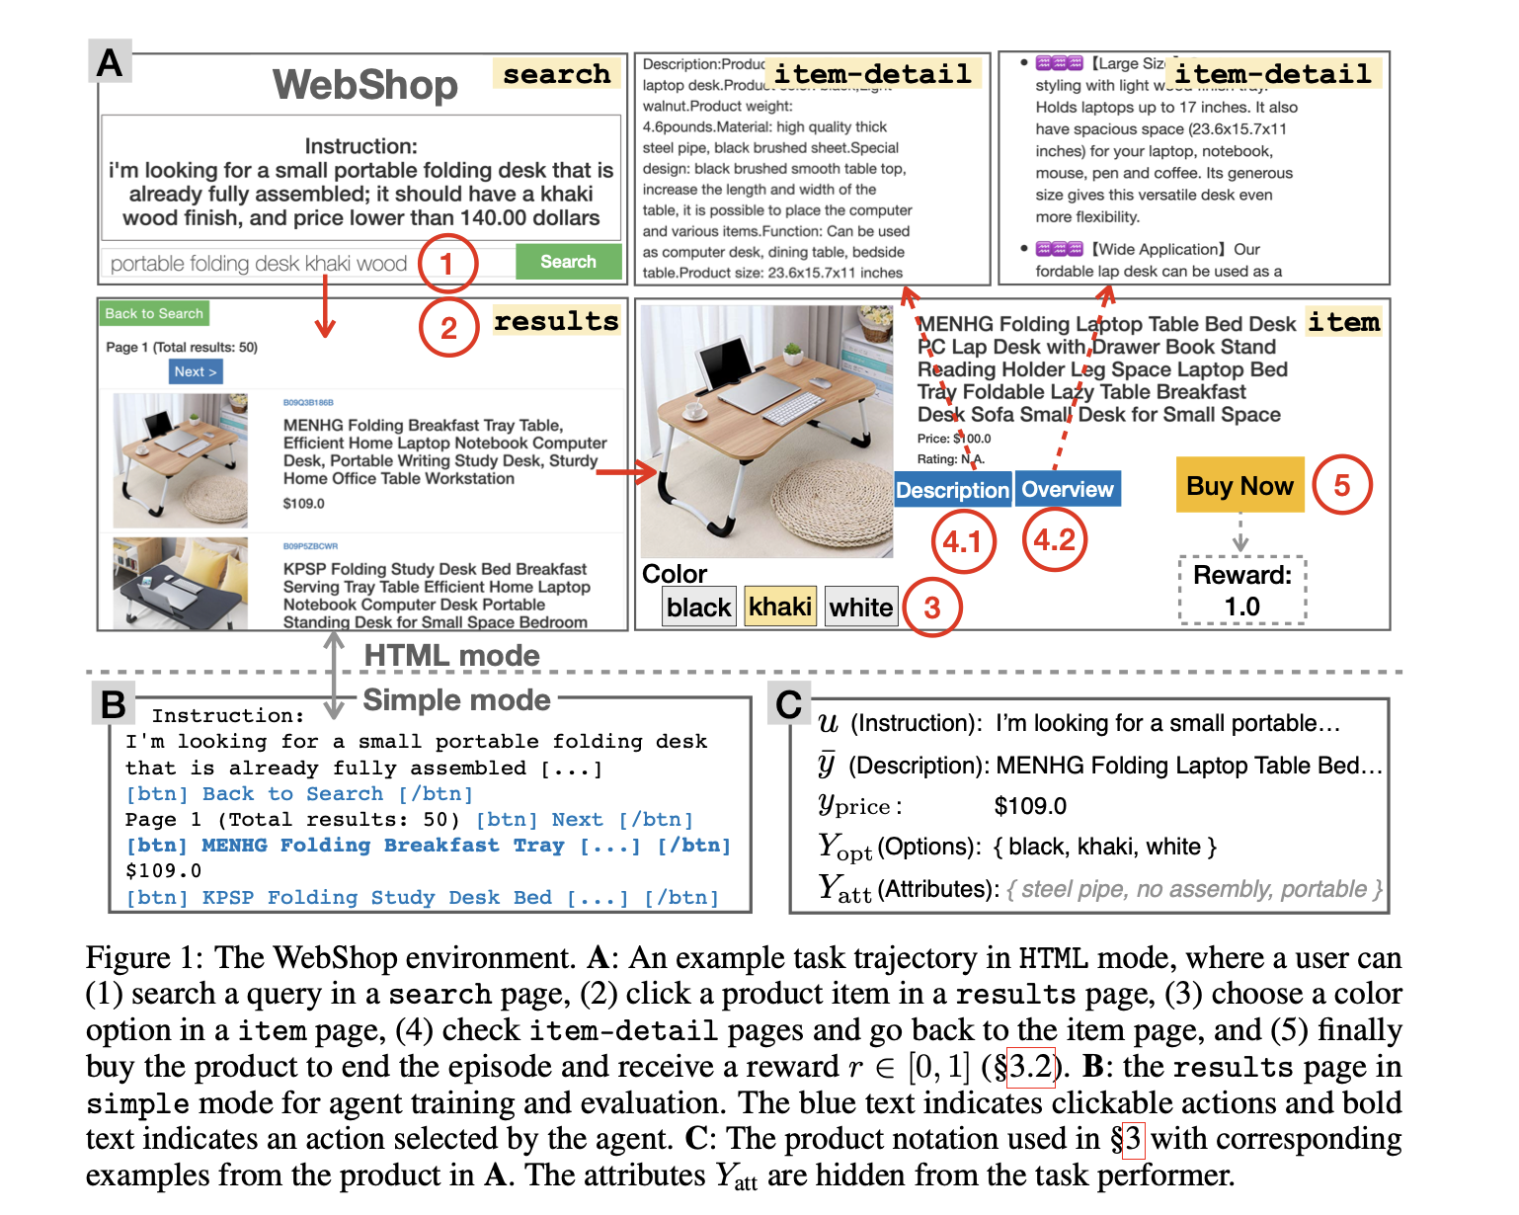
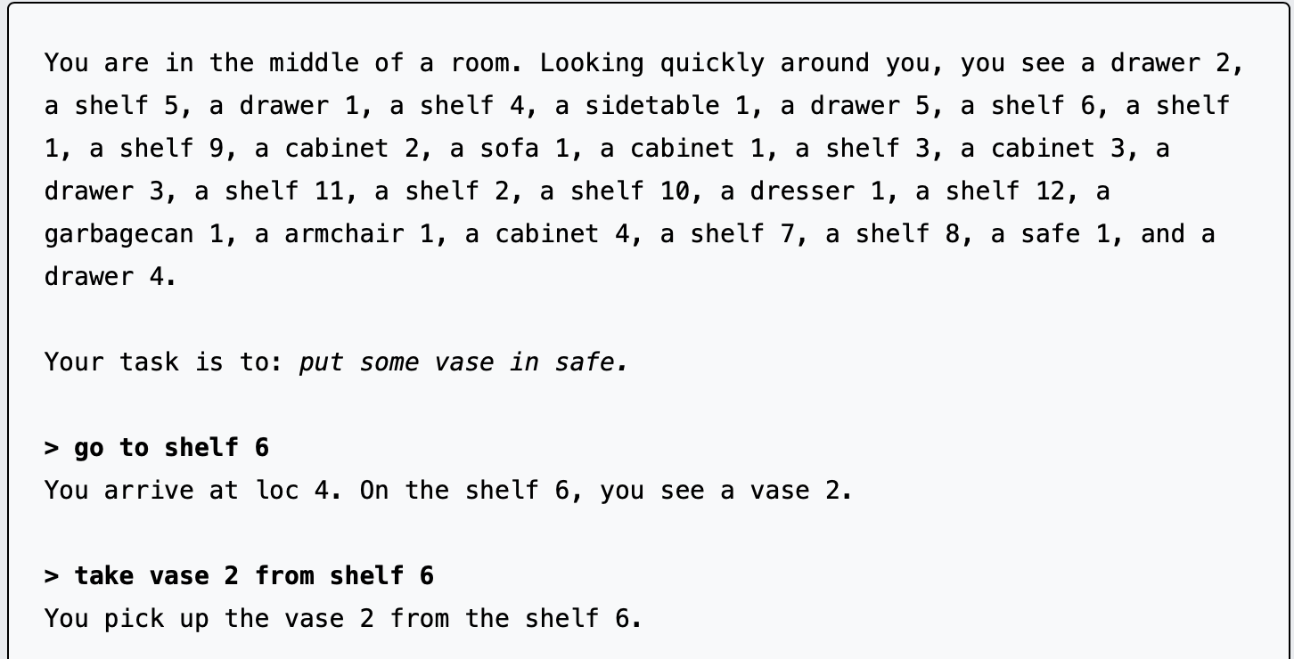
Datatsets
Decision-Making
ALFWorld: text game version of ALFRED
WebShop: simulated online shopping environment
Will see both of these again later on
Shridhar et al. (2020)
Yao et al. (2023)

Slide 48
QA Baselines
Standard prompting (just provide action directly, no thoughts)
CoT (allow thoughts but no observations/actions in ICL)
Acting-only (ACT): no thoughts
Another method
ReACT → CoT-SC
If ReACT fails to provide an answer, back off to CoT with self-consistency
Self-Consistency: Vote over multiple answers
Sample N CoTs and then take the majority answer

Slide 49
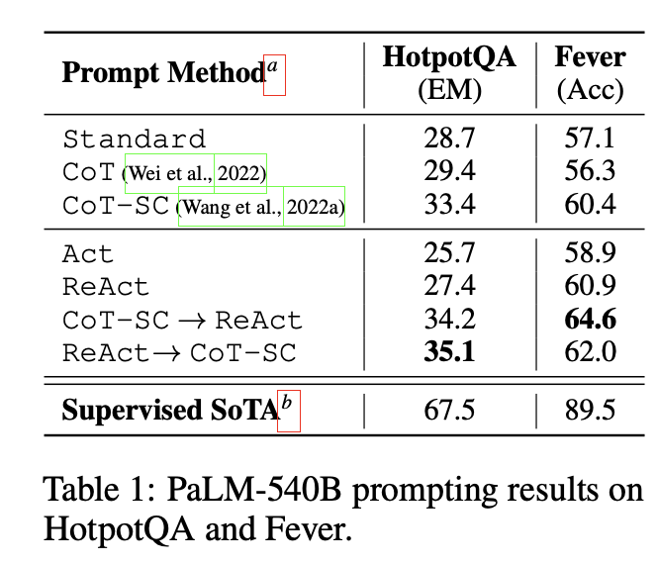
QA Results
ReACT > ACT
On PALM-540B (Google model from a few years ago, has been supplanted)
ReACT alone:
Not much better than Standard
Not much better than CoT
Worse/same as CoT-SC
ReACT + CoT-SC
Consistently better than baselines
Note: still far below full finetuning SOTA

Slide 50
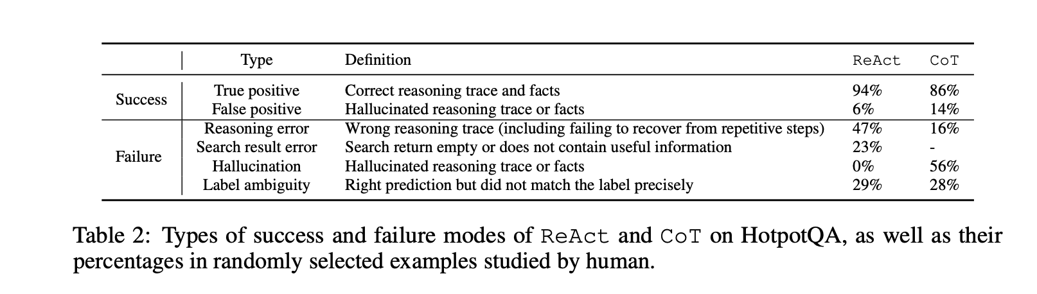
Where is performance/error coming from?
Error analysis
ReACT suffers from repetitive steps but has fewer hallucinations

Slide 51
Decision-making Baselines
ALFWorld:
ACT
BUTLER (supervised system from Shridhar et al. (2020))
Trained to copy successful trajectories, no thoughts
Not exactly fair comparison since this is trained, ReACT is not
WebShop
ACT
Their own supervised (imitation learning) baseline
Imitation learning + reinforcement learning

Slide 52
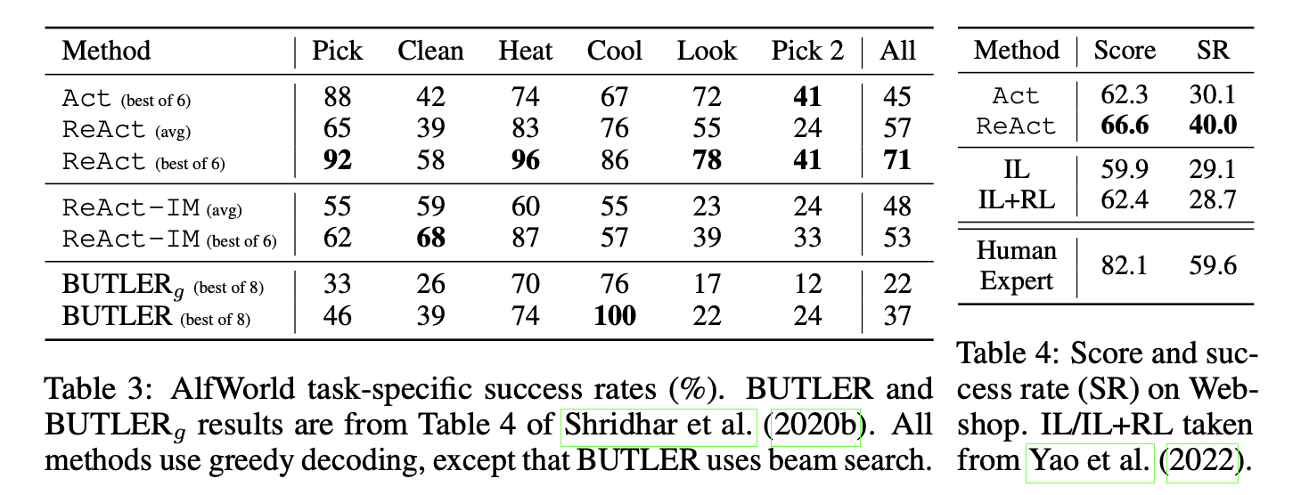
Decision-Making results
Metrics
Best of N trials
Success rate / Score

Slide 53
Decision-Making results
ReACT > ACT on ALFRED ReACT > BUTLER on ALFRED
Is this a fair comparison?
Hard to say
BUTLER was a custom architecture, trained largely from scratch (so some advantages, some disadvantages)
BUTLER is trained, but has far fewer parameters (used BERT embeddings)
ReACT uses PALM-540B, but not trained

Slide 54
Decision-Making results
On WebShop, ReACT > ACT
Also better than IL and IL+RL
Here, comparison is a bit fairer
IL and IL+RL models are more recent, Transformer-based
But still smaller

Slide 55
Takeaways
Remember, all of this is just conditioning
Ultimately the model is just a conditional distribution P(w | prefix)
All of these methods boil down to one thing: getting the prefix right s.t. the next word is right
This can mean 2 things
Next word is the right answer (e.g. the right action)
Next word is something that gets added to the prefix and leads eventually to the right answer (CoT, ReACT)
A lot of prompting comes down to this insight
Can you give your model the right conditioner (e.g. ICL examples)?
Can you get your model to produce the right conditioner (e.g. ReACT)?

Slide 56
Next class
Semantic parsing
Much more complex action spaces
Tool use
Interleave reasoning and action even more

